Slide 1
DATA SCIENCE CAPSTONE · MSDS640
Adult Census Income
Data Preparation and Exploratory Data Analysis
Erik Herb
M.S. Data Science · Bryant University
UCI Adult Census, 1994 U.S. Census · ~32,500 rows
Notes:
Quick framing: this is the data prep and EDA milestone for my capstone. The dataset is the UCI Adult Census Income data from the 1994 census, about 32,500 rows, and the task is predicting whether someone earns over 50K a year. Everything I do here is aimed at three hypotheses I'll show on the next slide. The one thing that's new since last time is that I use a decision tree to estimate feature importance, which came out of the feedback I got on the last milestone.

Slide 2
The task and the three hypotheses
I explored the data with these questions in mind, not just plotting for the sake of plotting
THE PREDICTION TASK
H1
Education over hours
Target
income >50K vs ≤50K
Rows
32,537 after cleaning
Models to come
Logistic Regression · XGBoost · MLP
Education level is a stronger driver of the >50K prediction than hours worked.
H2
Fairness across nativity
XGBoost is the fairest of the three models toward true high earners, with the smallest US-born vs foreign-born recall gap.
H3
XGBoost classifies best
XGBoost beats the logistic baseline and the MLP on PR-AUC and F1.
Notes:
The whole project is built around three hypotheses. H1 is a drivers question: does education matter more than hours. H2 is the fairness question: whether XGBoost has the smallest recall gap between US-born and foreign-born high earners. H3 is a straight model comparison. EDA can't fully settle any of these, but it can give early hints, and that's how I framed every plot.

Slide 3
1
Handling missing values
Only three columns had gaps, none badly affected
MISSINGNESS BY COLUMN
WHAT I DID AND WHY
Column | Missing | %
occupation | 1,843 | 5.66%
workclass | 1,836 | 5.64%
native_country | 583 | 1.79%
Filled all three with an explicit Unknown category instead of dropping rows.
Dropping every row with a gap would remove ~2,400 people
Missingness is not totally random (a missing workclass often pairs with a missing occupation), so dropping could bias the income analysis.
Unknown lets the model treat missingness as its own signal.
Removed 24 exact duplicate rows.
Done while fnlwgt was still in the table, since it is near-unique per row, so I only cut truly identical people.
Dropped fnlwgt and education.
fnlwgt is a survey sampling weight and education is redundant with the numeric education_num.
All three are categorical and well under any drop threshold.
Result: 0 missing values · final shape 32,537 × 14
Notes:
Only three columns had missing values, all categorical, all under six percent. I filled them with an Unknown category rather than dropping, because dropping would lose about 2,400 people and the missingness isn't random, so it could bias things. I also removed 24 exact duplicates, and dropped fnlwgt because it's a sampling weight the docs say not to use, and education because it duplicates education_num.

Slide 4
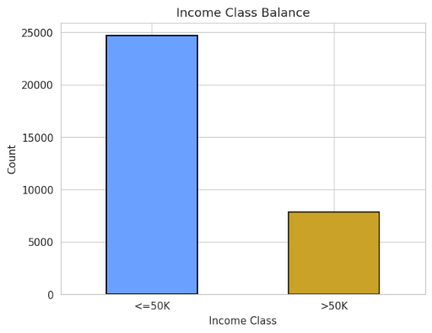
2
Class imbalance and metrics
About a 3.2 to 1 split, so accuracy alone would be misleading
WHY I LEAD WITH PR-AUC AND RECALL
Accuracy can be a trap when classes are heavily imbalanced: predicting nobody earns >50K scores ~76% while catching zero high earners.
Precision and recall split that apart; F1 combines them and is far more honest about the model’s performance
ROC-AUC can look strong just because the easy majority class will bring the score up.
PR-AUC only rewards finding the high earners I want to find, so it is my most reliable single number.
PLAN FOR THE IMBALANCE
SMOTE oversampling on the training split only, plus class weights, both compared against the raw imbalance.
Oversample the minority rather than undersample, so I keep every real row instead of throwing majority rows away.
Validation and test sets will stay untouched, so they still reflect the true population.
75.9% ≤50K 24.1% >50K
Notes:
The target is imbalanced, about 76 to 24, roughly 3.2 to 1. That means accuracy is misleading, because a model that says nobody earns over 50K is right 76 percent of the time but useless. So I lead with recall and PR-AUC. PR-AUC is the key one because it focuses on the positive class and doesn't get credit for the easy negatives the way ROC-AUC can. For the fix I plan SMOTE on the training split only plus class weights, oversampling instead of undersampling so I keep every real row, and I leave the test set alone so it stays realistic.
Class weights: model is forced to pay more close attention to the rare or underrepresented class and faces a much higher penalty for misclassifying the rare class compared to the majority class

Slide 5
3
Feature engineering and dimensionality
Three new features, each tied to a hypothesis
native_region
has_capital_gain / _loss
hours_group
US · non-US · Unknown
binary flags
6 ranges
Replaced original column “native_region” that is 90% United States into the split my fairness audit categories (Hypothesis 2) needs, keeping Unknown separate.
Almost everyone has zero capital gain or loss, with a few very large values
Using a yes or no flag column for having capital gains or not is a clearer signal than using the exact dollar amount
Bins hours worked, since the effect is not a straight line, part-time to full-time matters more than 50 to 60. Feeds the Hypothesis 1 comparison.
One-hot encoding
Standard scaling
No PCA
One-hot encoding turned each text column with each category into 52 numeric columns that the model can interpret from the original 8 categorical columns
Numeric features adjusted to mean of 0, standard deviation of 1, and fit on training only in the real pipeline.
Variance spread evenly across all principal components (26/21/20/18/16%).
Hypothesis 1 needs the original features, so reducing dimensionality using PCA would cost interpretability for little gain.
Notes:
I engineered three features, each tied to a hypothesis. native_region gives me the US vs non-US split the fairness audit needs. The capital gain and loss flags turn two heavily-zero columns into a clean wealth signal. hours_group bins hours because the effect isn't linear. Then one-hot encoding takes me to 52 features, standard scaling puts the numerics on the same range, and I checked PCA but skipped it: the variance is spread evenly and H1 depends on knowing which original feature matters.

Slide 6
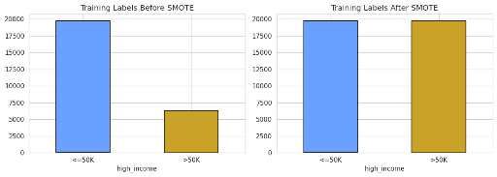
4
The impact of preprocessing
Before and after, plus a quick baseline to prove it mattered
BEFORE → AFTER
Missing: workclass 5.64%, occupation 5.66%, native_country 1.79% → 0%
Exact duplicates: 24 → 0
Train balance: 3.2 : 1 → 1 : 1 after SMOTE (training split only)
QUICK BASELINE LOGISTIC REGRESSION · SAME HELD-OUT TEST ROWS
0.39
→
0.79
Accuracy barely moved (0.815 → 0.819) But Recall Jumped Way Up
After preprocessing the model catches far more of the real high earners above $50k
Recall before
Recall after
>50K earners caught
on raw imbalanced data
scaling + encoding
+ SMOTE oversampling
Notes:
This is where I show it mattered. Missing values go from a few percent to zero, duplicates to zero, and the training balance from 3.2 to 1 down to 1 to 1 after SMOTE, but only on the training split. Then a quick default logistic regression makes the point: on the raw imbalanced data it catches only 39 percent of real high earners, and after scaling, encoding and oversampling the recall jumps way up while accuracy barely moves. That's exactly the trade I want for a lending use case. It's just a sanity check though, the real modeling is next milestone.

Slide 7
5
Summary statistics and outliers
describe(), frequency tables, and the IQR rule — and why I keep every flagged row
NUMERIC SNAPSHOT
OUTLIERS BY THE IQR RULE
 | mean | median | max
age | 38.6 | 37 | 90
education_num | 10.1 | 10 | 16
hours_per_week | 40.4 | 40 | 99
capital_gain ($ amount) | 1,078 | 0 | 99,999
hours_per_week
27.7%
capital_gain
8.3%
capital_loss
4.7%
education_num
3.7%
age
0.4%
CATEGORICAL FREQUENCY (TOP VALUES)
workclass: Private 22,673 dominates; Unknown 1,836
marital_status: Married-civ-spouse 14,970, Never-married 10,667
sex: Male 21,775, Female 10,762
native_region: US 29,153, non-US 2,802, Unknown 582
Why IQR, not z-scores: z-scores assume a symmetric normal shape, but capital gain (skew ~12) and hours are skewed, so they would mislabel ordinary points. IQR makes no such assumption.
Why I keep them: dropping every flagged row deletes 39.7% of the data and 47.2% of ALL high earners. Capital-gain outliers are 61.8% high earners — they ARE the signal. Hours flags 27.7% only because 46.7% work exactly 40h — the IQR collapses to 5.
Notes:
For summary stats, age is centered near 38, education around 10 years, hours piled at 40, and capital gain is mostly zero with a giant max. On the categorical side, Private workclass and married dominate.
For outliers I used the IQR rule instead of z-scores, because z-scores assume a normal shape and capital gain has a skew around 12, so z-scores would flag a lot of ordinary points.
The more important question is what I do about the flagged rows, because the rule flags a lot of them. I keep all of them, and I checked what dropping them would cost rather than just asserting it.
First, dropping every flagged row would delete about 40 percent of my data and 47 percent of all my high earners. Nearly half the class I'm trying to predict. For a project about finding high earners, that ends the argument by itself.
Second, the flagged rows are the signal, not noise. Rows flagged on capital gain are 62 percent high earners against 21 percent for everyone else, and they're about a fifth of every high earner in the dataset. Capital gain is also my strongest feature on permutation importance. So the outliers on my best feature are exactly the people I most want to catch.
Third, the hours flag rate is an artifact of the rule. Because 47 percent of people work exactly 40 hours, the interquartile range collapses to 5, from Q1 of 40 to Q3 of 45, which puts the fence at 32 to 52 hours. So a 55-hour week gets called an outlier. That's not an anomaly, that's a job. The 27.7 percent is measuring the spike at 40, not measuring errors.
Fourth, and this is the one I'd lead with if asked: dropping would bias my fairness audit. Foreign-born people get flagged at 45 percent against 39 percent for US-born, so I'd be disproportionately removing people from the smaller group that H2 audits, and then measuring the nativity gap on a sample I'd already skewed by nativity.
The short version: an IQR flag means a value is far from the middle. It does not mean the value is wrong. These are real people with real recorded incomes, and tree models split on order rather than magnitude, so the skew doesn't hurt them.

Slide 8
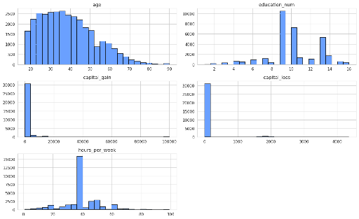
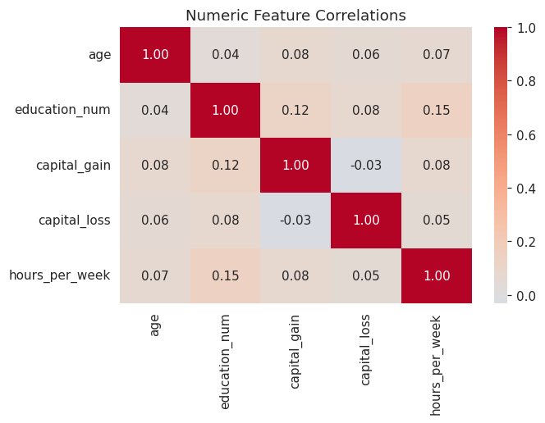
6
Core distributions and correlations
The shape of the data before reading it against the hypotheses
NUMERIC DISTRIBUTIONS
NUMERIC CORRELATIONS
Age is right skewed
Education clusters at 9 to 10 (high school)
Hours are highly concentrated at 40
Capital gain and loss are almost all zero.
Every off-diagonal correlation is small: no multicollinearity, which keeps the logistic regression coefficients stable and readable (Hypothesis 1)
Notes:
A quick look at the raw shape of the data. The histograms confirm what the stats said: age bell-shaped, education clustered at high school, hours spiking at 40, and capital gain and loss basically all zero, which is why I built the flags. The correlation heatmap shows every numeric pair is only weakly related, so there's no multicollinearity to worry about. That matters because the logistic regression coefficients stay stable and readable, and H1 depends on reading those coefficients.

Slide 9
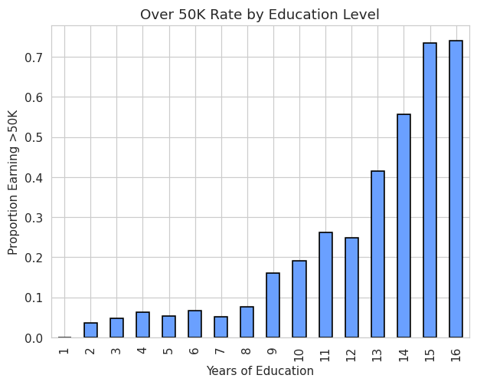
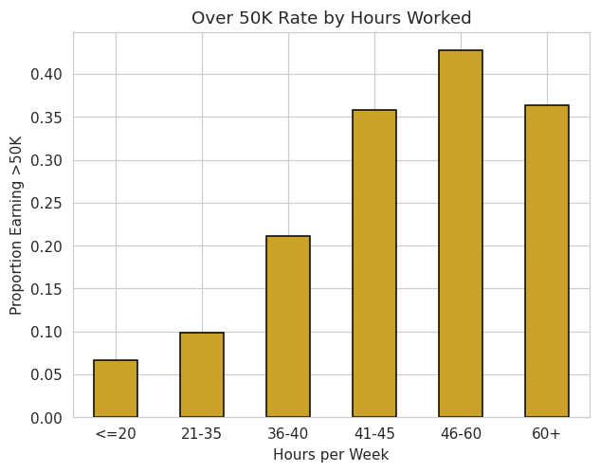
H1
H1: education beats hours worked
Rate spread first, then a decision tree with every feature competing at once
>50K RATE BY EDUCATION
>50K RATE BY HOURS
RATE SPREAD
share of people (taken from mean count of individuals from high_income binary target variable) within each education level or hours bin who earn over 50K
0.741
education
0.361
hours
Education spreads the rate roughly 2× wider.
Takeaway The rate spread is only a one-feature view, so I fit a decision tree that puts every feature in competition. Education still wins: 0.223 vs 0.028 on tree importance and 0.099 vs 0.023 on permutation importance measured on held-out rows. Both measures agree on the direction, so H1 has real support. Marital status and capital gain do rank above education, which H1 does not claim either way.
Notes:
H1 asks whether education drives income more than hours. The rate spread is the one-feature view: education spreads the over 50K rate 0.74 against 0.36 for hours, roughly double. But that doesn't control for anything, so I fit a decision tree, which my professor suggested. A tree picks its splits with every feature competing at once, which is exactly what H1 needs.
Education wins there too, about eight times larger on the tree's own importance and about four times on permutation importance.
I report both on purpose. The tree's built-in measure is based on impurity reduction and it's known to favor continuous features. Education is a single numeric column while my categorical features are spread across a lot of one-hot columns, so the built-in number could flatter education for the wrong reason. Permutation importance on held-out rows is the cross-check, and the fact that both agree on direction is what makes me trust it. The drop from 0.223 to 0.099 between the two is that bias showing up right where I expected.
One thing to be straight about: marital status ranks above education on the tree at 0.426, and capital gain ranks first on permutation importance. H1 only claims education beats hours worked, which it does, so that doesn't change the result. It just means I can't say education leads every feature.

Slide 10
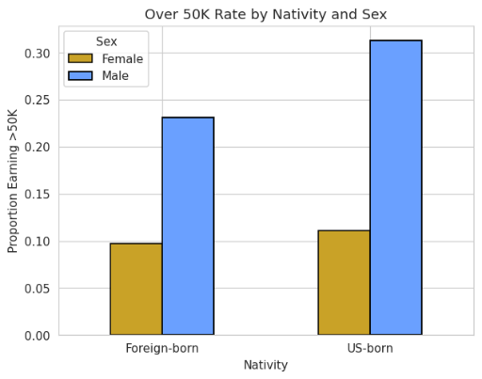
H2
A real base-rate gap across nativity
The gap the fairness audit will measure as a recall gap
>50K RATE BY NATIVITY AND SEX
THE GAP
24.6% US-born vs 18.7% foreign-born
US-born people earn >50K at a higher base rate. Unknown region sits near the US rate at 25.1%.
WHY IT MATTERS
If a model just learns this gap, it misses real foreign-born high earners: a higher false-negative rate (results in a lower recall, for that group)
That per-group recall gap is exactly what the fairness audit measures, and Hypothesis 2 predicts XGBoost has the smallest one.
Splitting by sex shows men are higher in both groups, so the audit checks sex and race alongside nativity, not just nativity alone.
Notes:
H2 is the fairness question, and here I'm just showing the base-rate gap the models will be audited against. US-born earn over 50K at about 25 percent versus 19 percent for foreign-born. If a model simply learns that gap, it'll miss real high earners among foreign-born people, which shows up as lower recall for that group, and that recall gap is what the audit measures. Breaking it out by sex shows men are higher in both groups, so nativity isn't the only thing moving the base rate, which is why the audit checks sex and race too.

Slide 11
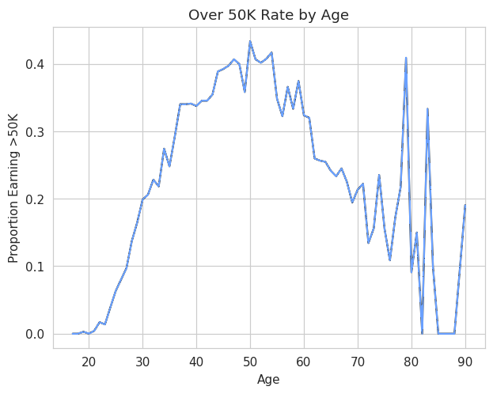
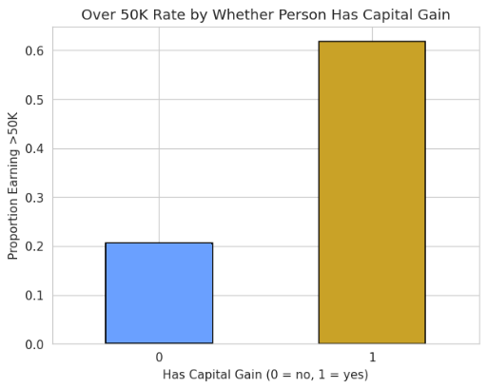
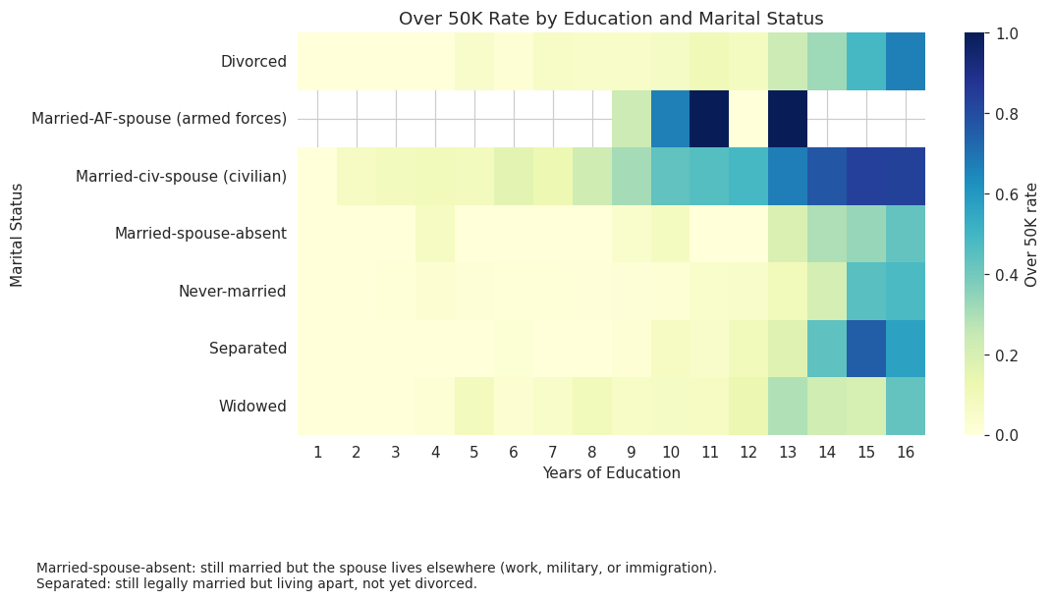
H3
Patterns the flexible models can exploit
Non-linearity, thresholds, and interactions favor trees and networks
AGE: A CURVE, NOT A LINE
CAPITAL GAIN: A THRESHOLD
INTERACTION CHECK
Non-linear
Threshold
Interaction
The >50K rate rises then falls with age. A linear model reads age as one straight effect; a tree or net captures the bend.
Any capital gain flips the >$50k rate from low to high as an association, a sharp cutoff that tree model splits handle naturally.
.High pay rates show up where high education and being married occur together, not from either alone. XGBoost and MLP can pick up on those kinds of combined patterns.
Notes:
H3 is the model comparison. EDA can't test it, but it can show whether the data has the kind of patterns flexible models exploit. Three things: the over-50K rate by age is a clear curve that rises and falls, which a linear model can't bend to on its own. Having any capital gain flips the rate from low to high, a threshold that tree splits handle naturally. And the education-by-marital-status heatmap shows an interaction, married plus high education is higher than either alone. All three favor XGBoost and the MLP over the linear baseline, consistent with H3. Whether XGBoost actually wins, and whether it's significant, is the McNemar and bootstrap test next milestone.

Slide 12
Where the EDA leaves each hypothesis
H1
Education spreads the >50K rate wider and cleaner than hours, and once a decision tree puts every feature in competition, education still beats hours on both importance measures (~8x on tree, ~4x on permutation). Real support for H1.
H2
A real US-born vs foreign-born base-rate gap that holds up alongside sex. This is the recall gap the fairness audit will measure per model.
H3
Non-linear (age), threshold (capital gain), and interaction (education × marital status) patterns are present, consistent with expecting XGBoost to classify best.
*No single feature cleanly separates the two income groups, so these are early hints rather than actual proof. But nothing in the EDA cuts against these three hypotheses either.
Notes:
Where each hypothesis stands. H1 has real support now: education beats hours on both importance measures once the decision tree puts every feature in competition. H2 has a real base-rate gap for the fairness audit to measure. H3 sees the non-linear, threshold and interaction structure that flexible models exploit. None of these are settled by EDA, but nothing in the data cuts against them either.

Slide 13
Thank you
Any questions?

